Slide 1
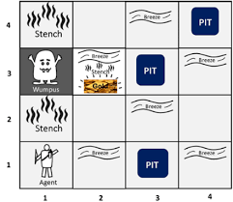
Wumpus World Simulator using Deep Q-Learning algorithm to build an agent
Presented by: Gary Sampson
Date: December 8, 2021

Slide 2
Objectives:
Compare the performance of an Actor-Critic algorithm to the DQN algorithm given in the example code
Compare the performance of a Double DQN algorithm to the DQN algorithm given in the example code
For the Double DQN algorithm, remove the feature that keeps track of whether the agent has the arrow available or not and see how much it degrades the agent’s performance.
With a 6X6 game grid environment, add a 3X3 convolutional layer to the DQN algorithm and compare their performance. Remove an hidden layer and compare the performance.

Slide 3
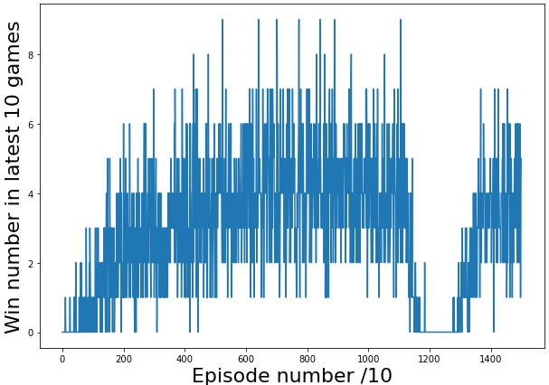
Actor-Critic algorithm with dense layers
Algorithm trained on 15,000 epochs
Average reward: 70

Slide 4
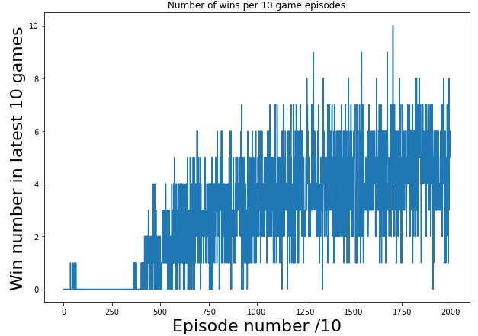
Actor-Critic algorithm with dense layers
Algorithm trained on 20,000 epochs
Average reward: 218

Slide 5
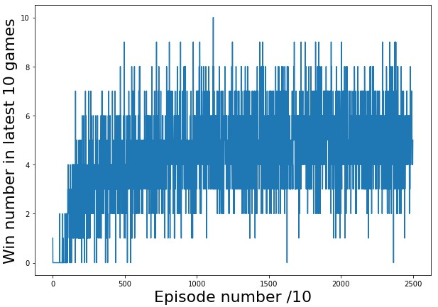
Double DQN algorithm with dense layers
Algorithm trained on 25,000 epochs
Average reward: 308

Slide 6
Algorithm Performance
Algorithm | Epochs | Average Reward
Actor-Critic with dense layers and 4X4 game grid environment. | 15,000 | 70
Actor-Critic with dense layers and 4X4 game grid environment. | 20,000 | 218
Double DQN with dense layers and 4X4 game grid environment. | 25,000 | 308
Double DQN with dense layers and 4X4 game grid environment. Removed the feature that keeps track of whether the agent has the arrow available or not. | 25,000 | 297
DQN with 3X3 convolutional layer, 3 hidden dense layers and 6X6 game grid environment. | 10,000 | -166
DQN with 3X3 convolutional layer,2 hidden dense layers and 6X6 game grid environment. | 10,000 | -153

Slide 7
Summary
While training the actor-critic algorithm with 15,000 epochs, the agent suffered “catastrophic forgetting” at approximately 12,000 epochs. Increased the training to 20,000 epochs resulted in improved performance with an average reward from 70 to 218.
DeepMind’s Double DQN algorithm outperformed the original DQN.
The Double DQN’s performance degraded slightly when the feature that keeps track of whether the agent has the arrow available or not was removed.
The DQN algorithm performed poorly with an added 3X3 convolutional layer and a 6X6 game environment. Removing a hidden dense layer did not improve performance.

